Slide 2
exploring streaming sensor data.

Slide 3
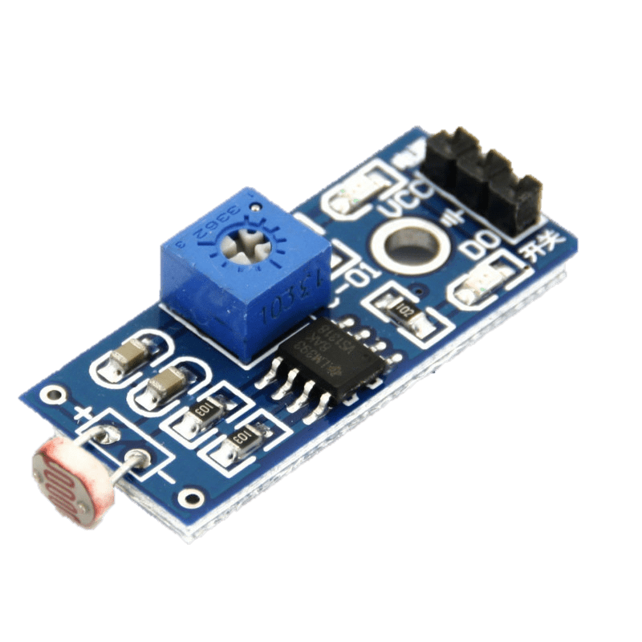
Introduction
Low-power sensor hardware

Slide 4
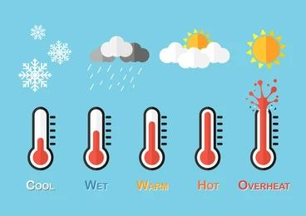
Introduction

Slide 5
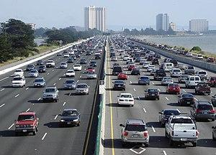
Introduction
Road Traffic

Slide 6
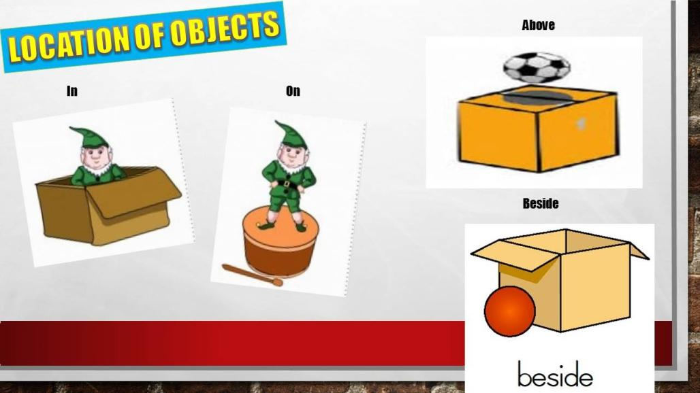
Introduction

Slide 7
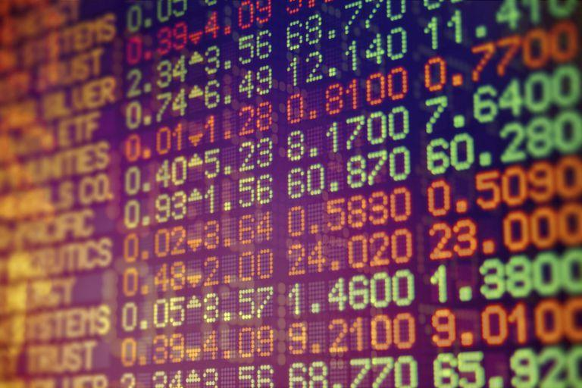
Introduction
Prices on the stock market

Slide 8
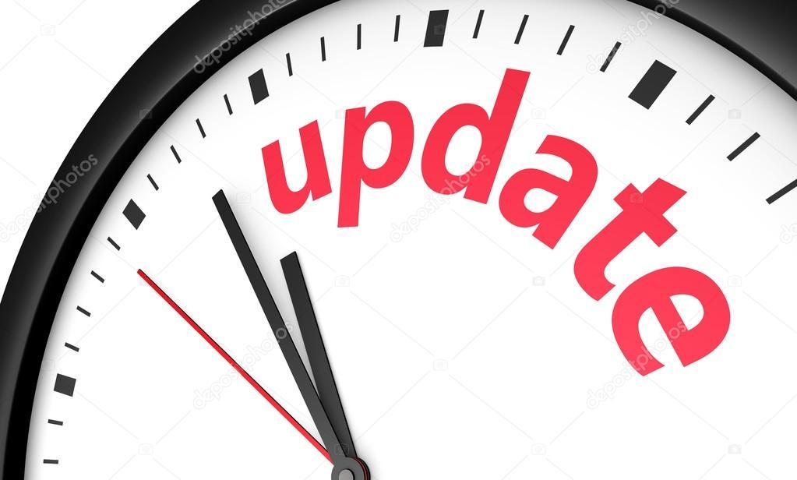
Introduction

Slide 9
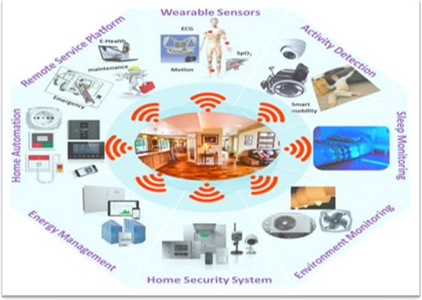
Introduction
Detailed information about the situation
people are in

Slide 10

Introduction
Detailed information about the situation
people are in

Slide 11
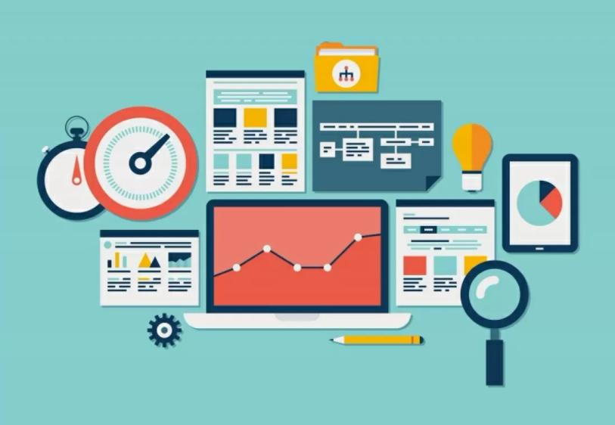
Introduction
Bridging the gap between sensor data and application information

Slide 12
Supply side: sensors

Slide 13

Supply side: sensors

Slide 14
Supply side: sensors
motion

Slide 15
Supply side: sensors
motion | acceleration

Slide 16
Supply side: sensors
motion | acceleration | angular velocity

Slide 17
Supply side: sensors
motion | acceleration | angular velocity | magnetic field

Slide 18
Supply side: sensors
motion | acceleration | angular velocity | magnetic field | pressure

Slide 19
Supply side: sensors
motion | acceleration | angular velocity | magnetic field | pressure | altitude

Slide 20
Supply side: sensors
motion | acceleration | angular velocity | magnetic field | pressure | altitude | temperature

Slide 21
Supply side: sensors
measurement system errors
noise
uncontrolled conditions

Slide 22
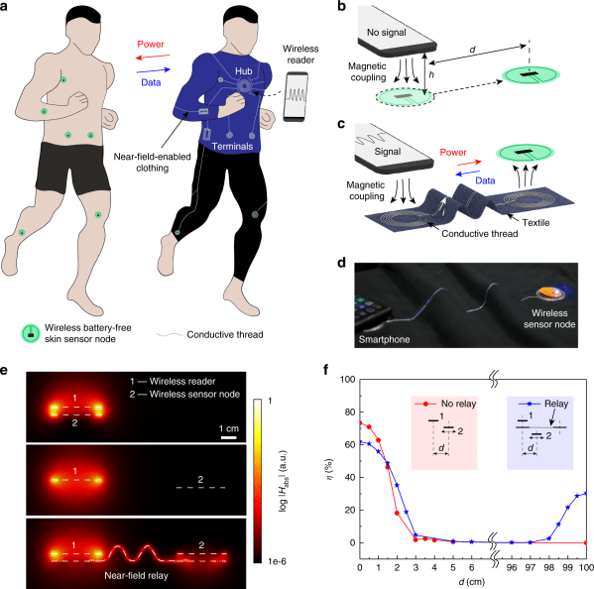
Supply side: sensors

Slide 23
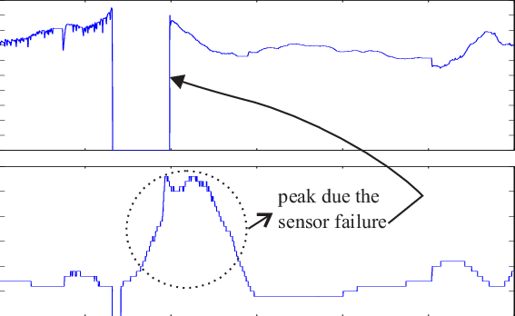
Supply side: sensors
Sensor failure

Slide 24
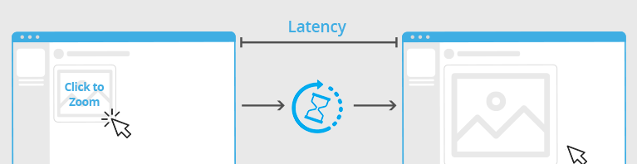
Supply side: sensors
Network latency

Slide 25
Supply side: sensors
A couple of remarks to sketch the situation:
Sensors come and sensors go.
Sensors do not produce clean data.
The same sensor may be used for different purposes
The data rate and latency may differ greatly between sensors/algorithms, and over time.
They might only produce data “on demand”

Slide 26
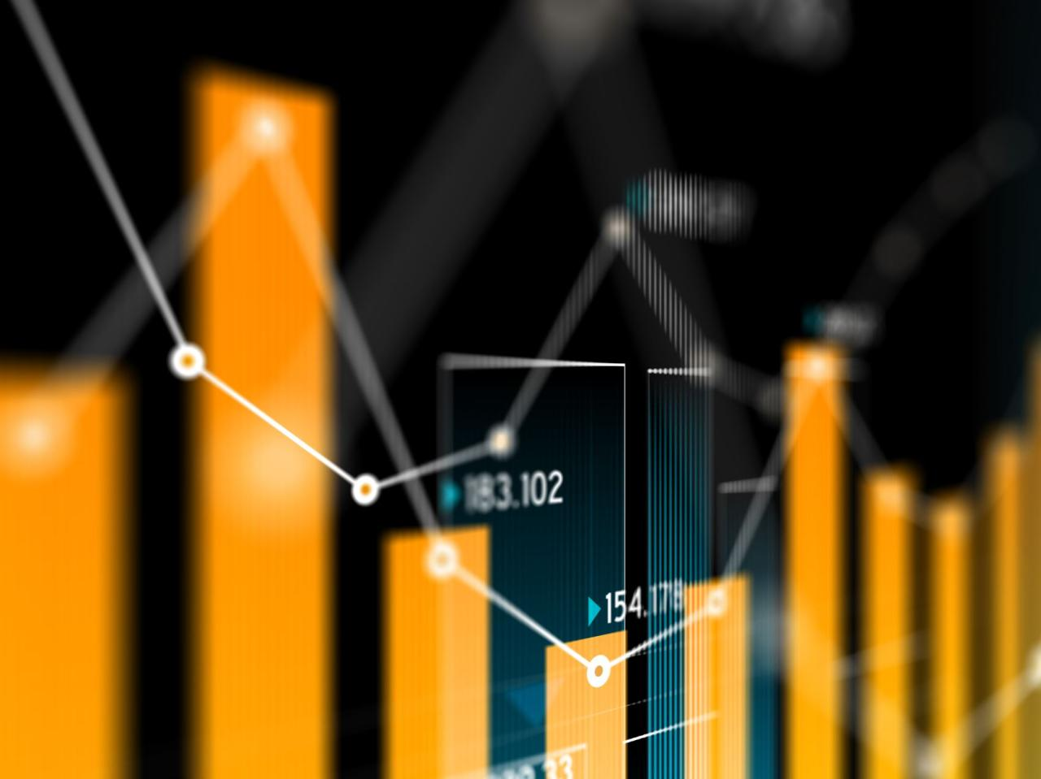
Demand side: applications

Slide 27
Demand side: applications
Demand side: applications
Applications come and go
They might want to know what kind of sensors are around,
They might be totally decoupled from sensors
They might have (static or dynamic) requirements
They might demand a ‘memory’ from the environment
They might be interested in trends or summaries

Slide 28
Demand side: applications
Applications come and go
They might want to know what kind of sensors are around,
They might be totally decoupled from sensors
They might have (static or dynamic) requirements
They might demand a ‘memory’ from the environment
They might be interested in trends or summaries

Slide 29
Uses of sensor data

Slide 30
Uses of sensor data
Health industry
Weather prediction
Sound analysis
Video streaming

Slide 31
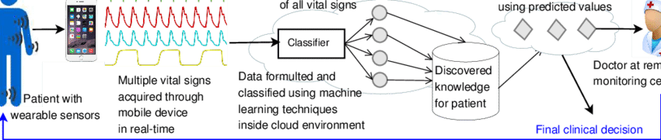

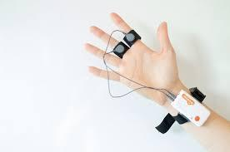
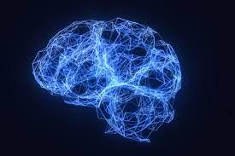
Health sensor data
Heart rate
Electrodermal activities
Brain waves

Slide 32
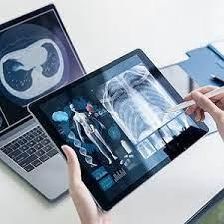
Health sensor data
ICT Technology to diagnose patients

Slide 33
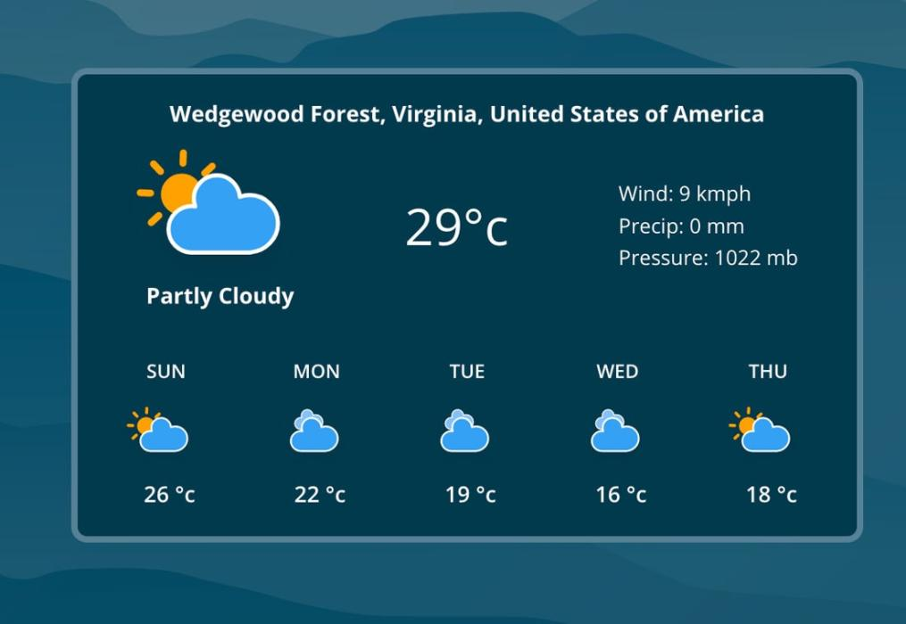
Weather data

Slide 34
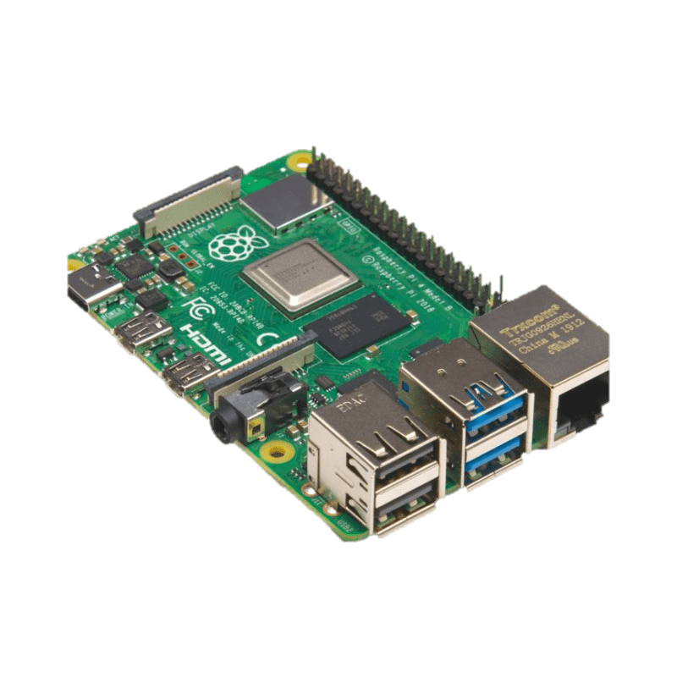
Sensor data from IOT things
Raspberry Pi

Slide 35
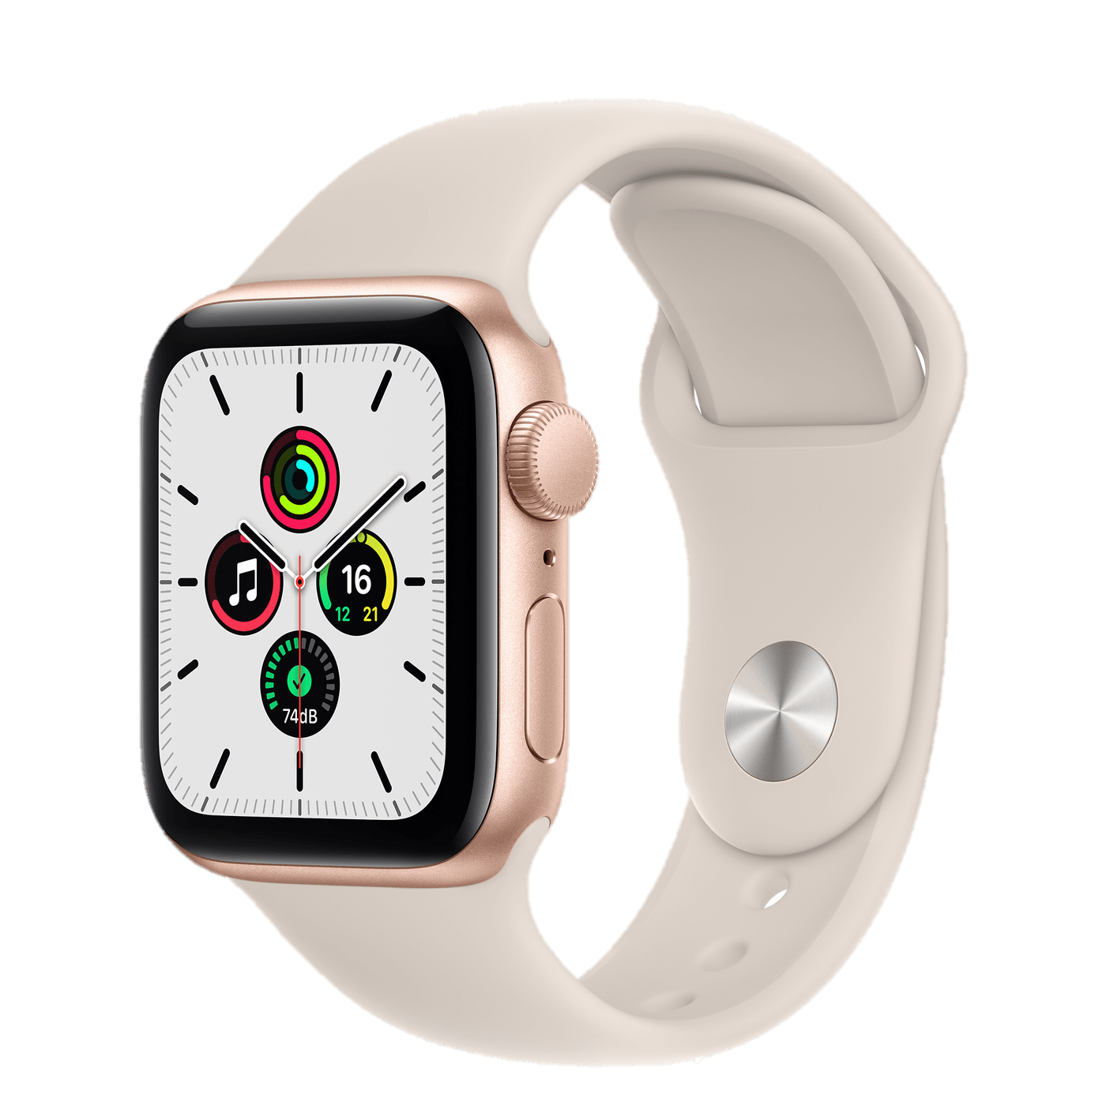
Sensor data from IOT things
Raspberry Pi
Apple Watch

Slide 36
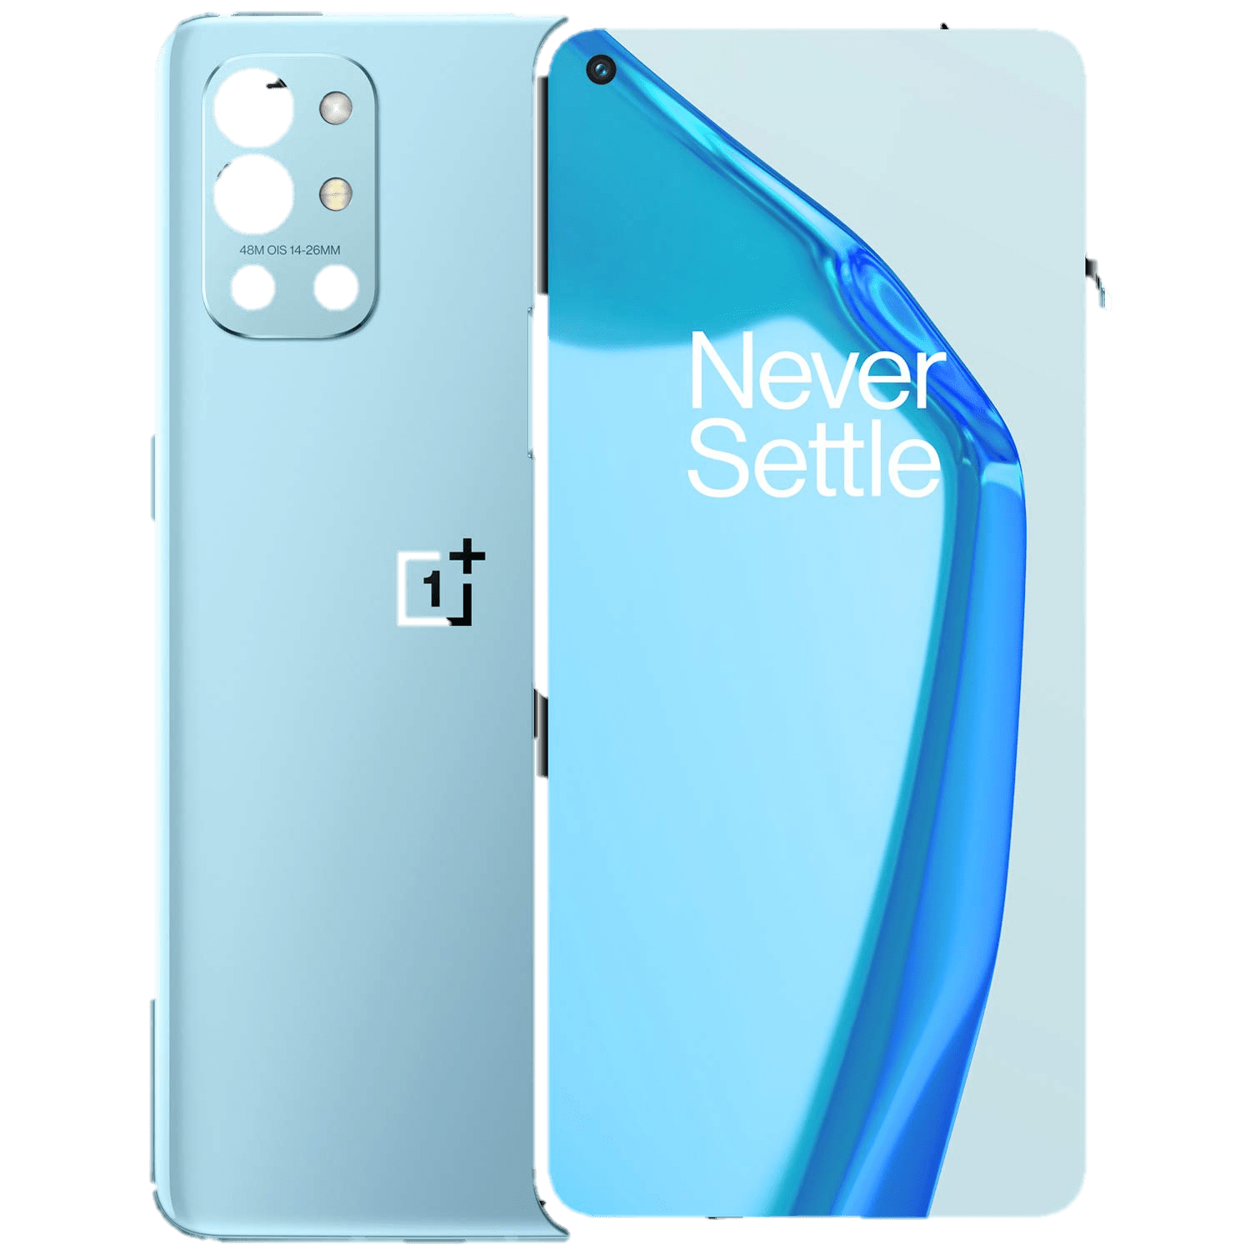
Sensor data from IOT things
Smart Phone

Slide 37
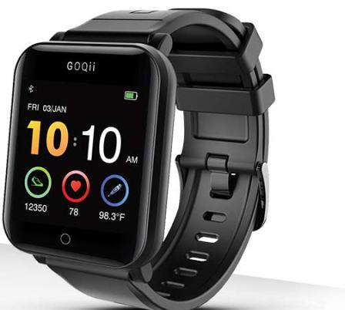
Sensor data from IOT things
Smart Phone
Health watches

Slide 38
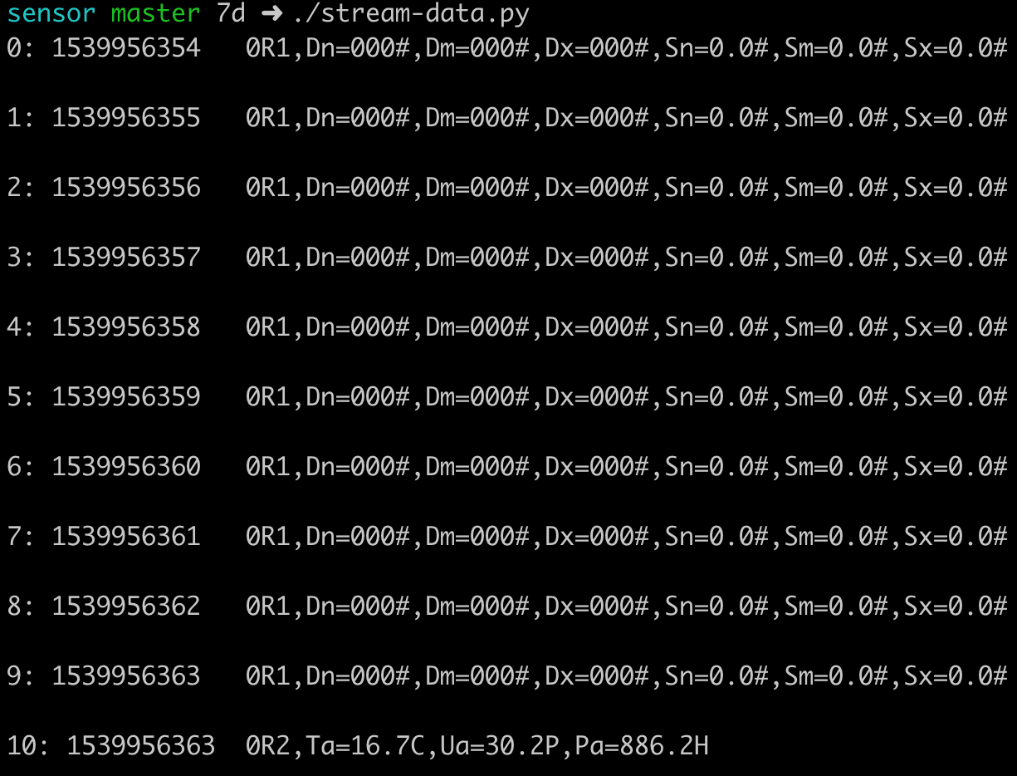
Exploring streaming sensor data from a weather station

